Slide 1
Therapist Profile Template
Click to start presentation

Slide 2
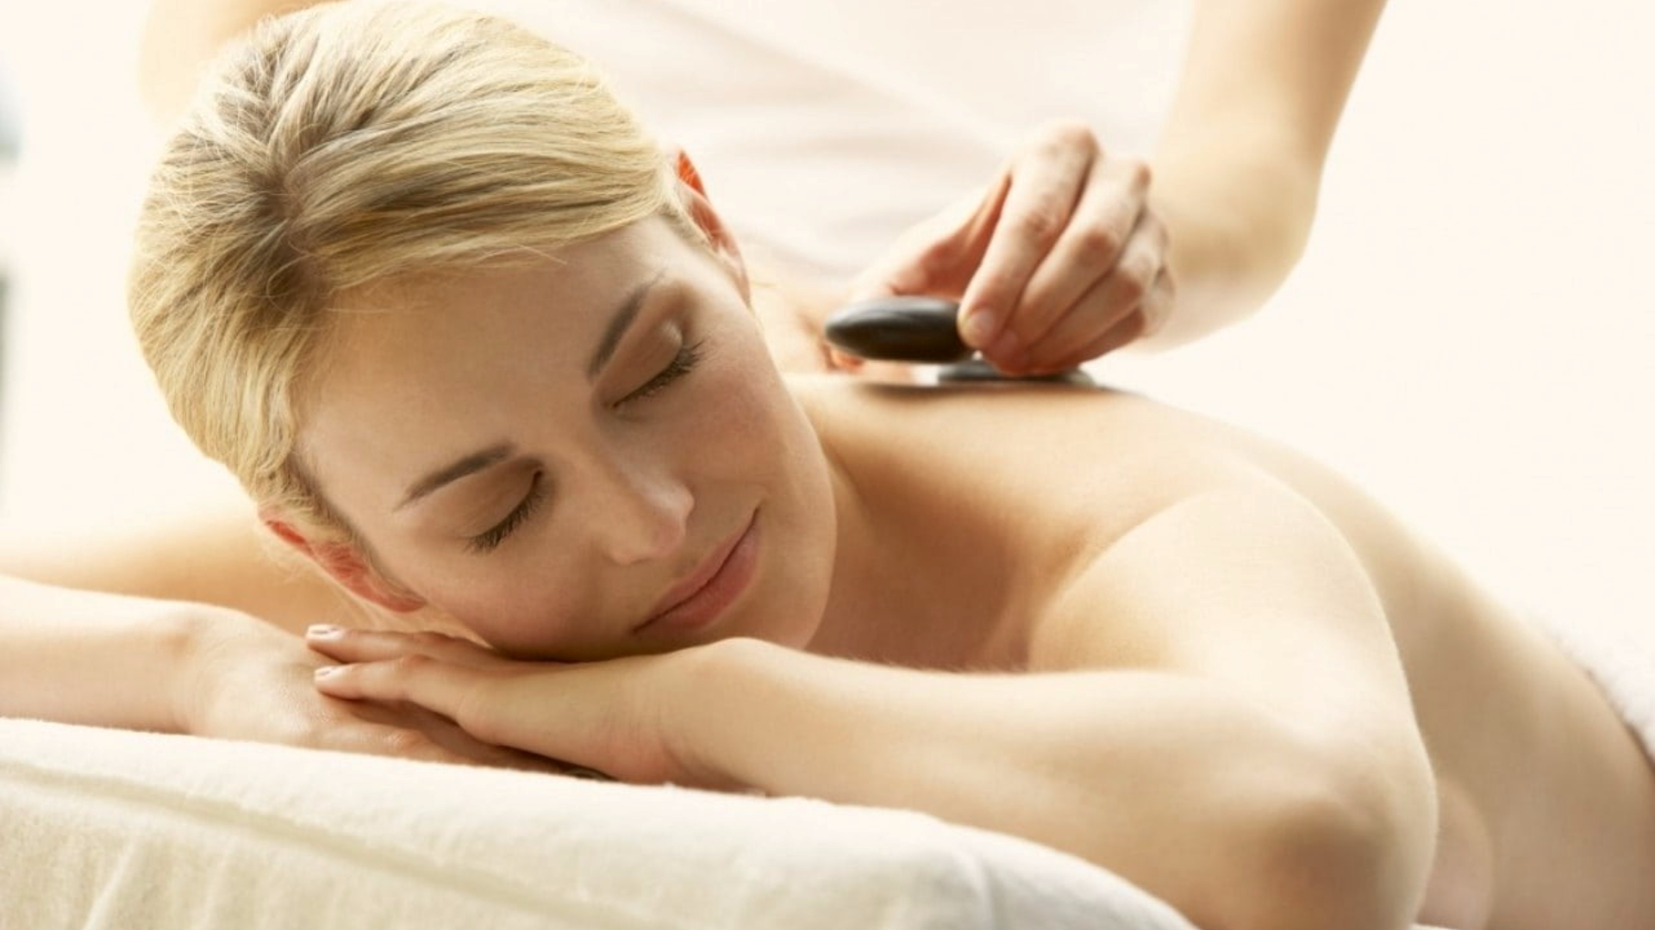

Home
Notifications
Schedule
About us
Services
Contacts
Profile
Sign out
Germany Mobile Spa
Relax. Rejuvenate. Renew.
Discover the healing power of touch. Our expert massage therapies not only melt away stress but also improve circulation, relieve muscle tension, and promote overall well-being. Invest in your health —because you deserve it.
Find your closest therapist

Slide 3


Home
Notifications
Schedule
About us
Services
Contacts
Profile
Sign out
Germany Mobile Spa
Personal Details
Professional Details
Profile picture
First name*
Last name*
Sex*
Age*
Services Settings
Stephany
Anniston
Female
25
Equipment Preferences
Full address*
Kitaibelite 30, Berlin 10034
Availability
Upload new
Email address*
Phone number*
Financial Settings
Delete
XXXXXXXXXXXX@gmail.com
+49 XXX XXX XXXX
Booking History
Customer Reviews
Notification Settings
Privacy and Security
Support
Save Changes
Discard Changes

Slide 4


Home
Notifications
Schedule
About us
Services
Contacts
Profile
Sign out
Germany Mobile Spa
Profile picture
Personal Details
Professional Details
Years of experience
Specialties
3
Deep Tissue Massage, Thai Massage
Services Settings
Equipment Preferences
Certifications
Availability
Certificat...pdf
Bachelor...pdf
ID – Fron...png
Financial Settings
Booking History
Certificat...pdf
Masters...pdf
ID – Back ...png
Customer Reviews
Upload files
Notification Settings
Privacy and Security
Support
Save Changes
Discard Changes

Slide 5
Home
Notifications
Schedule
About us
Services
Contacts
Profile
Sign out
Germany Mobile Spa
Profile picture
Personal Details
Professional Details
Offered Services
time / price in euros time / price in euros time / price in euros
Services Settings
Thai Massage
60 minutes
25
90 minutes
40
120 minutes
50
Equipment Preferences
Relaxing Oil Massage
60 minutes
90 minutes
120 minutes
Deep Tissue Massage
60 minutes
20
90 minutes
35
120 minutes
Availability
Slimming Massage
60 minutes
90 minutes
120 minutes
Financial Settings
Jet Lag Recovery Massage
60 minutes
90 minutes
120 minutes
Booking History
Myofascial Massage
60 minutes
90 minutes
120 minutes
Pregnancy Massage
60 minutes
90 minutes
120 minutes
Customer Reviews
Foot Massage
60 minutes
90 minutes
120 minutes
Notification Settings
Foot Scrub
60 minutes
90 minutes
120 minutes
Privacy and Security
Body Scrub
60 minutes
90 minutes
120 minutes
Facial Treatment
60 minutes
90 minutes
120 minutes
Support
Manicure
60 minutes
90 minutes
120 minutes
Pedicure
60 minutes
90 minutes
120 minutes
Yoga Personal Training
60 minutes
90 minutes
120 minutes
Group Preferences
Single
Couples
Group sessions
Client Gender Preferences
Male
Female
No Preference
Save Changes
Discard Changes

Slide 6
Home
Notifications
Schedule
About us
Services
Contacts
Profile
Sign out
Germany Mobile Spa
Profile picture
Personal Details
Professional Details
Provided Equipment from therapist
Enter equipment name
Add to list
Services Settings
5 Towels 2 Chairs
Equipment Preferences
Availability
Financial Settings
Required Equipment from client
Enter equipment name
Add to list
Booking History
1 Table 1 Bed
Customer Reviews
Notification Settings
Privacy and Security
Support
Save Changes
Discard Changes

Slide 7
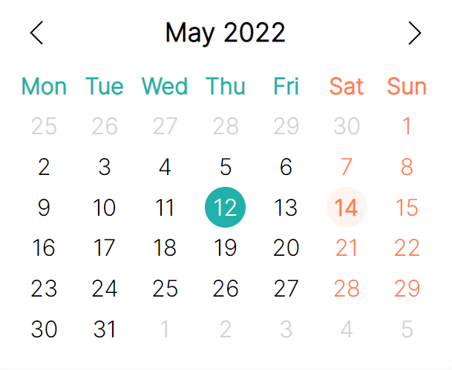
Home
Notifications
Schedule
About us
Services
Contacts
Profile
Sign out
Germany Mobile Spa
Profile picture
Personal Details
Professional Details
Availability Status
Available
Unavailable
Services Settings
GPS Tracking
Turn on
Turn off
Equipment Preferences
Availability
Weekly availability
From
To
Monday
00:00 am
00:00 am
Financial Settings
Tuesday
00:00 am
00:00 am
Booking History
Wednesday
00:00 am
00:00 am
Thursday
00:00 am
00:00 am
Customer Reviews
Friday
00:00 am
00:00 am
Saturday
16:30 pm
22:30 pm
Notification Settings
Sunday
08:00 am
22:30 pm
Privacy and Security
00:00 am
06:00 am
12:00 pm
18:00 pm
00
01:00 am
07:00 am
13:00 pm
19:00 pm
15
02:00 am
08:00 am
14:00 pm
20:00 pm
30
03:00 am
09:00 am
15:00 pm
21:00 pm
45
04:00 am
10:00 am
16:00 pm
22:00 pm
Support
05:00 am
11:00 am
17:00 pm
23:00 pm
Add your holidays
Choose a date
Scheduled holidays
Add description
22nd March 2025 – Dad has operation
My daughter has a birthday
12th May 2025 – my daughter has a birthday
Add selected date
from calendar
Remove selected date from schedule
Save Changes
Discard Changes

Slide 8
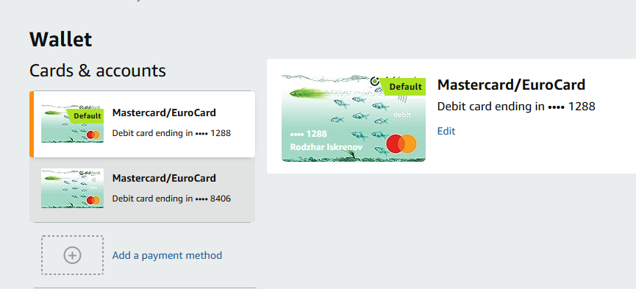
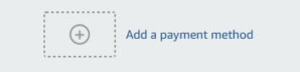
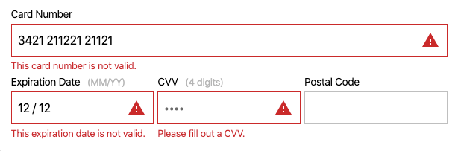
Home
Notifications
Schedule
About us
Services
Contacts
Profile
Sign out
Germany Mobile Spa
Profile picture
Personal Details
Professional Details
Cards & accounts
Services Settings
Add bank account
Add PayPal account
Add Stripe account
Equipment Preferences
Full name of bank account holder
Bank name
Anna Müller
Deutsche Bank
Availability
Street Number Postcode
Blumenstraße
23
10115
Financial Settings
City
Country
Berlin
Berlin
Booking History
Bank account number
Customer Reviews
1234567890
IBAN – Bank account number
Notification Settings
DE89 1007 0000 1234 5678 90
SWIFT Code (BIC)
Privacy and Security
DEUTDEBBXXX
Support
Minimum booking payment threshhold in € (euros)
25
This setting will make sure you only receive booking requests for the setup price or more
Save Changes
Discard Changes

Slide 9
Home
Notifications
Schedule
About us
Services
Contacts
Profile
Sign out
Germany Mobile Spa
Profile picture
Personal Details
Professional Details
Search by name, service, location, duration, price
Search
Services Settings
Customer name
Service
Location
Date
Duration
Price (€)
Equipment Preferences
Anna Müller
Thai massage
Rosenweg 5, 80331 München
12/01/2025
60 mins
25
Maximilian Schmidt
Foot massage
Lindenallee 7, 40210 Düsseldorf
35
24/03/2024
90 mins
Emma Fischer
Pregnancy massage
Hauptstraße 12, 10115 Berlin
07/06/2025
60 mins
25
Availability
Leon Wagner
Body scrub
Am Markt 14, 28195 Bremen
19/08/2025
120 mins
65
Yoga personal training
Sonnenstraße 30, 01067 Dresden
Sophia Meyer
30/11/2024
90 mins
75
Financial Settings
Booking History
Customer Reviews
Notification Settings
Privacy and Security
Support

Slide 10
Home
Notifications
Schedule
About us
Services
Contacts
Profile
Sign out
Germany Mobile Spa
Profile picture
Personal Details
Professional Details
Search by name, service
Search
Services Settings
Customer name
Service
Review
Rating
Equipment Preferences
Anna Müller
Thai massage
This was the best thai massage of my life
4/5
Maximilian Schmidt
Foot massage
The lady knows what shes doing
4/5
Emma Fischer
Pregnancy massage
I felt my baby kick for the first time
5/5
Availability
Leon Wagner
Body scrub
Not the worst but I won‘t go again
3/5
Sophia Meyer
Yoga personal training
The yoga trainer was very professional, I can see how he has many years of experience. I was very surprised when he showed me the move with bending your knees.
5/5
Financial Settings
Booking History
Customer Reviews
Notification Settings
Privacy and Security
Support

Slide 11
Home
Notifications
Schedule
About us
Services
Contacts
Profile
Sign out
Germany Mobile Spa
Profile picture
Personal Details
Professional Details
All notifications
Turn on
Turn off
Mute
Services Settings
Notification preferences
Push
SMS
Email
Equipment Preferences
Reminders before service
Turn off
Turn on
How long before
15 minutes
30 minutes
1 hour
2 hours
3 hours
5 hours
10 hours
Availability
Financial Settings
Booking History
Customer Reviews
Notification Settings
Privacy and Security
Support
Save Changes
Discard Changes

Slide 12

Home
Notifications
Schedule
About us
Services
Contacts
Profile
Sign out
Germany Mobile Spa
Profile picture
Personal Details
Professional Details
Hide Profile from Public View
Turn off
Turn on
Services Settings
Password*
Confirm Password*
Equipment Preferences
Update Password
***************
***************
Save Password
Forgotten Password
Availability
Financial Settings
Security Question
Remove
***************
Booking History
Security Answer
Remove
***************
Customer Reviews
Request account data download
Notification Settings
Request account data deletion
Privacy and Security
Delete account
Support
Save Changes
Discard Changes

Slide 13
Home
Notifications
Schedule
About us
Services
Contacts
Profile
Sign out
Germany Mobile Spa
Profile picture
Personal Details
Professional Details
FAQ
Services Settings
Where can I see my previous customers? How to access the calendar with all my bookings?
How to delete my account?
Where to see my reviews?
Equipment Preferences
Availability
You don‘t see the answers you are looking for?
Financial Settings
Write us an email
Topic
Booking History
Customer Reviews
Notification Settings
Up to 2000 letters
Privacy and Security
Support
Save Changes
Discard Changes

